Slide 1
Pro-Con Debate:
Subclavian vs Internal Jugular
Central Venous Catheters
Pro- Internal jugular catheters
Arthur M Lam MD, FRCPC, FNCS
Clinical Professor of Anesthesiology
Attending Neurointensivist
University of California, San Diego

Slide 2
Mechanical/Technical Considerations for all patients
Neurosurgical/Neurologic patients

Slide 3
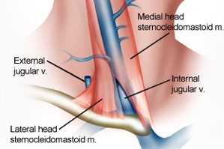
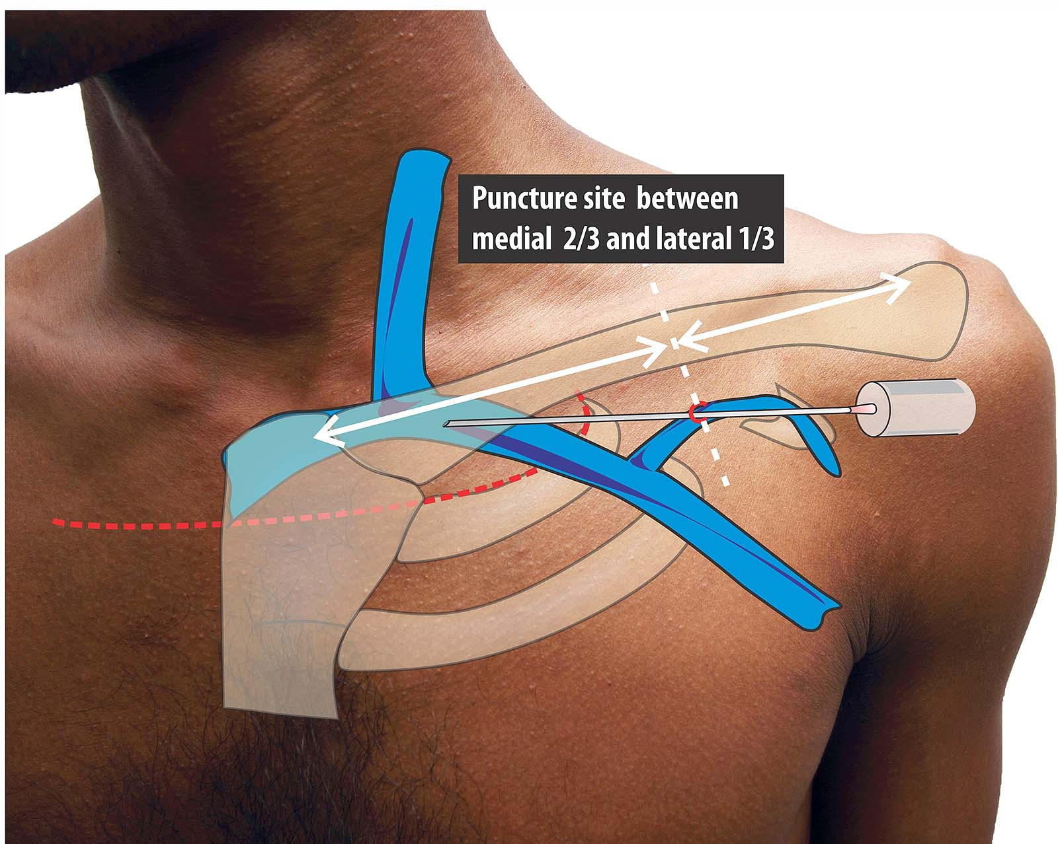
Advantages:
Landmarks:
Easy & obvious Obscure
Ultrasound:
Friendly Not
Pneumothorax risk:
Exceedingly low Not
Chylothorax risk:
None yes, if left-sided

Slide 4
ABSTRACT: Based on two recent papers, internal jugular access is associated with a low rate of severe mechanical complications in the intensive care unit as compared with subclavian access, and it is preferable for short-term access (<5–7 days) and for haemodialysis catheters. Subclavian access is associated with a lower risk for infection and is the route of choice, in experienced hands, if the risk for infection is high (central venous catheter placement >5–7 days) or if the risk for mechanical complications is low.

Slide 6
Risk of pneumothorax
=1.5%

Slide 7
Internal Jugular Subclavian
Technical difficulty:
Low High
Anxiety factor:
Low High
Experienced mentor:
Many Fewer
Compressibility:
Yes, with caution Not
Infection risk
Low Lower
Learning experience
Limited Chest tube bonus

Slide 8
Neurosurgical/Neurologic Considerations
Myths and Facts
Elevation of ICP from venous obstruction - Myth
Risk of venous thrombosis – low risk at short term, higher risk long term - Fact

Slide 9
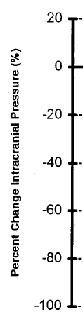
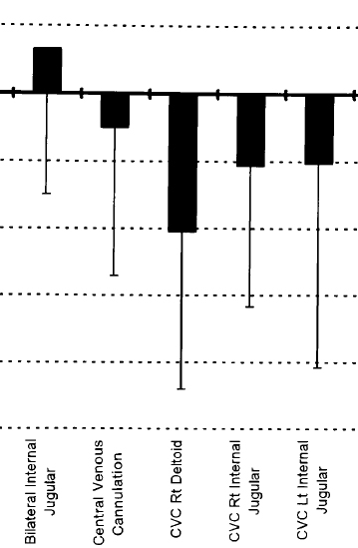

Slide 10
Pre-insertion (mmHg) After insertion
Mean age: 8.9 ± 6 17.3 ± 5.1 17.2 ± 5.1
Max increase: 2 mmHg in a single patient

Slide 12
Jugular bulb monitoring
Pubmed: 384 citations

Slide 13
In 32 comatose TBI patients both internal jugular veins (IJs) were simultaneously explored using intermittent samples; hemoglobin saturation was also recorded continuously by fiber-optic catheters in five patients. In five cases long catheters were inserted bilaterally upstream, up to the sigmoid sinuses.

Slide 15
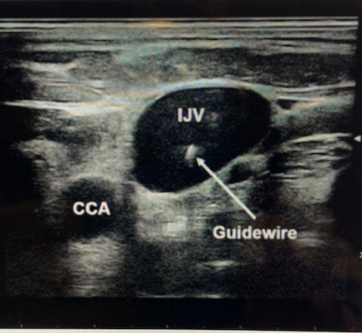

Slide 16
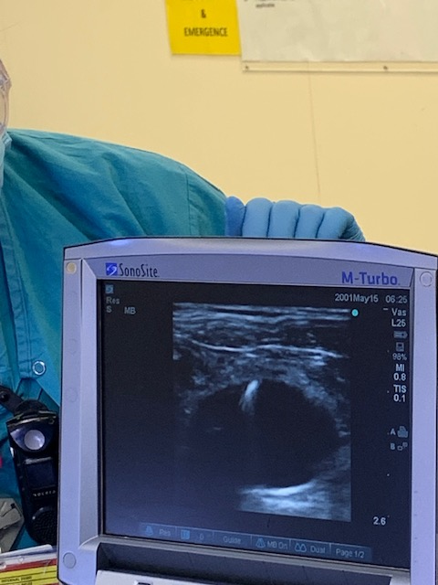

Slide 17
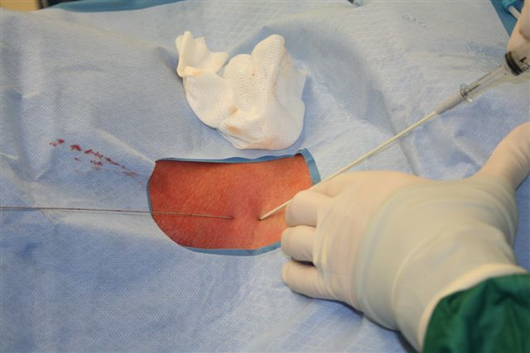

Slide 18
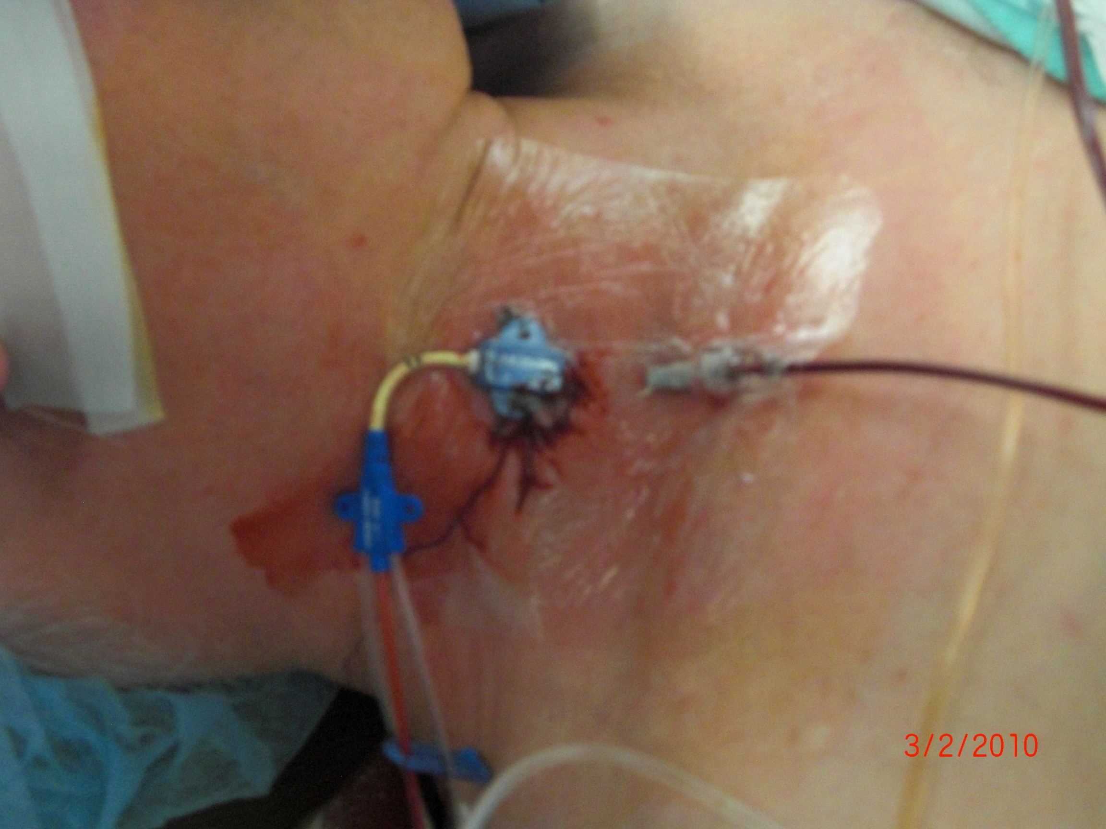

Slide 19
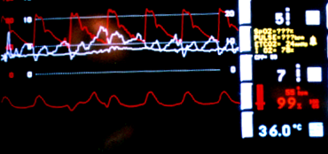
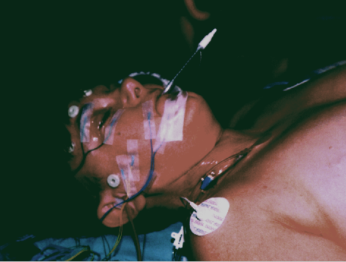
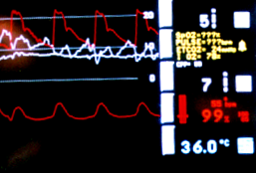
Neutral Position

Slide 20
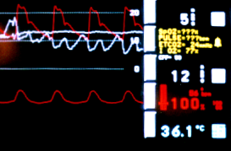
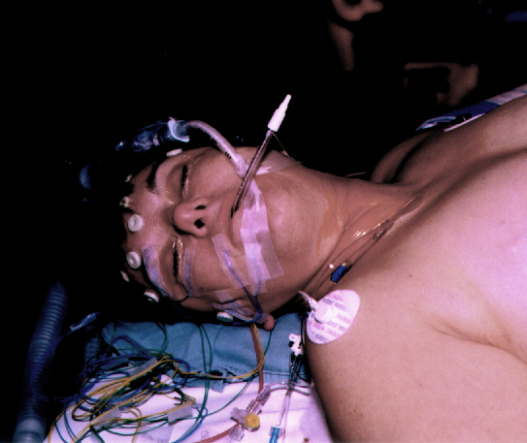
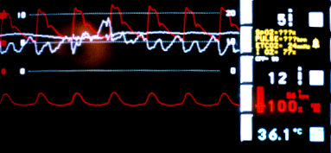
Head Turned to Right

Slide 22
The greater the ignorance the greater the dogmatism
Sir Willian Osler

